Slide 1

Retail Intelligence System
End-to-End Data Engineering, Machine Learning & Business Analytics
SYRINE HOUSSEINI • ENIS • APRIL 2026

Slide 2
Agenda
A structured walkthrough of our predictive ecosystem.
Introduction & Objectives
Data Pipeline & Preprocessing
Predictive Modeling (Churn & Revenue)
Interactive Web Deployment

Slide 3

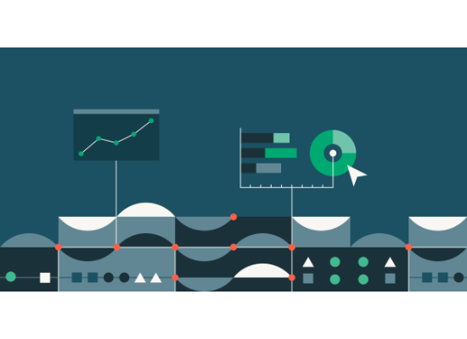
The Retail Analytics Challenge
Problem Statement
Retail industries generate massive volumes of transactional data. However, many organizations lack integrated systems to translate this data into actionable intelligence.
We face three core analytical challenges:
Targeting: Identifying distinct customer groups.
Retention: Predicting churn before it occurs.
Forecasting: Accurately predicting lifetime revenue.

Slide 4









System Objectives
Scalable Pipeline
Predictive Models
Deployment
Build a robust data engineering framework to ingest, clean, and preprocess retail transactions seamlessly.
Develop robust ML models for classification (churn) and regression (revenue), alongside unsupervised clustering.
Deploy an interactive, Flask-based dashboard to provide real-time business insights for decision-makers.

Slide 5


Dataset Description
Key Features
Target Variables
The dataset captures comprehensive retail transactions and customer behavior patterns.
We aim to predict two distinct outcomes to drive business value.
•
CustomerID: Unique identifier
•
Churn: A binary indicator mapping whether a customer has stopped purchasing completely.
•
InvoiceDate: Transaction timestamp
•
•
Quantity: Number of items purchased
Monetary Total: A continuous numerical value representing total lifetime customer spending.
•
UnitPrice: Price per individual unit
•
Country: Geographic location of customer

Slide 6


Dual Prediction Targets
01
02
Churn (Classification)
Revenue (Regression)
Binary prediction of customer retention
Continuous prediction of monetary value

Slide 7
System Architecture
Our solution utilizes a modular design ensuring separation of concerns, scalability, and maintainability.
Data Input: Ingest raw retail CSVs.
Data Processing: Cleaning, scaling, and engineering features.
Machine Learning: Training KMeans, XGBoost, and Regression models.
Dashboard: Rendering insights via REST APIs.

Slide 8



Data Preprocessing Pipeline
Missing Values
Encoding
Feature Selection
Numerical features imputed using median strategies. Categorical variables rely on mode imputation to maintain distribution integrity.
One-hot encoding applied to low-cardinality nominal features, with label encoding reserved for ordinal relationships.
Highly correlated and irrelevant features are aggressively filtered out using correlation thresholding mechanisms.

Slide 9
Handling High Cardinality
Features with excessive unique categories, such as CustomerID, inherently cause model noise and are strategically excluded from the predictive modeling phase.
"
— Pipeline Design Principles

Slide 10

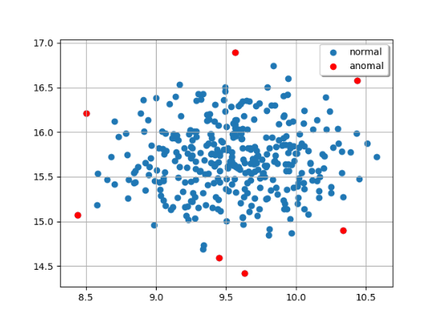
Outlier Detection
Isolation Forest Algorithm
In high-dimensional retail datasets, traditional statistical bounds fail to capture multidimensional anomalies.
We utilized the Isolation Forest algorithm, which isolates anomalies based on random feature partitioning. Because outliers are "few and different," they are isolated closer to the root of the tree structures, making detection highly efficient and scalable.

Slide 11


Temporal Feature Engineering
The Challenge
The Extraction
Raw timestamps (e.g., InvoiceDate) are not directly interpretable by most machine learning algorithms. They represent absolute moments rather than behavioral trends, making it difficult for models to capture cyclical or recency-based patterns.
We decompose timestamps into structured numerical features:
•
Year: Captures cohort effects and macro trends.
•
Month: Encodes seasonality and holiday cycles.
•
Recency: Measures time since last interaction.

Slide 12
Why Temporal Features Matter
Recency indicates retention: Customers who have interacted recently present a statistically lower risk of churning.
Seasonality dictates spending: Monthly purchase patterns effectively capture holiday rushes, promotional cycles, and recurring consumption habits.
Enhancing clustering: Providing explicit time signals allows algorithms like K-Means to group users by behavioral loyalty rather than just total spend.
Model performance boost: These features transform raw logs into structured insights, establishing the foundation for all downstream predictive models.

Slide 13
Dimensionality Reduction
Overcoming the curse of dimensionality using Principal Component Analysis (PCA).

Slide 14
The Impact of PCA
We standard scaled the data and reduced the feature space to 10 principal components. This projection achieves several critical improvements:
Reduces Noise: Eliminates redundancy in highly correlated customer behavioral features.
Computational Efficiency: Significantly decreases training time across complex classification models.
Improves Separation: Enhances the clarity of boundary margins for K-Means clustering.
Prevents Overfitting: Simplifies the feature space allowing churn models to generalize better on unseen data.

Slide 15











The Four Identified Clusters
VIP Customers
Stable Customers
Occasional Customers
At-Risk Customers
High spending levels with consistent, high-frequency engagement.
Regular purchasing behavior with moderate overall activity.
Irregular patterns, buying sporadically throughout the year.
Very low engagement metrics and high probability of imminent churn.

Slide 16
Business Value of Segmentation
Personalized Marketing: Tailor campaigns specifically to the behavior profile of each cluster.
Identify High-Value Targets: Focus retention programs and premium offers on the VIP segment to maximize ROI.
Early Intervention: Detect At-Risk customers early and deploy targeted discounts to re-engage them.
Resource Optimization: Allocate support and sales resources efficiently based on customer lifetime potential.

Slide 17
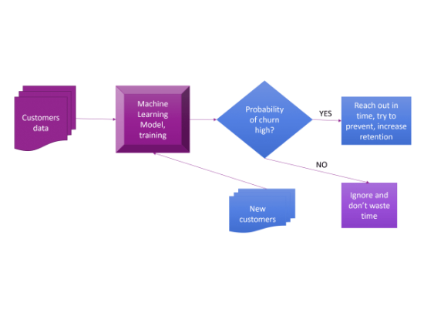
Churn Prediction System
Binary Classification Task
Churn prediction is formulated as a supervised problem. The objective is to proactively predict whether a customer will stop using the service (Churn = 1) or remain active (Churn = 0).
This early-warning mechanism is essential for modern customer retention, transitioning business strategies from reactive to proactive.

Slide 18
Solving Class Imbalance
To prevent bias toward the non-churn majority, we applied SMOTE (Synthetic Minority Oversampling Technique) to intelligently generate synthetic samples of the minority class.
"
— Ensuring Balanced Generalization

Slide 19









Models Evaluated
We trained and tested four distinct classification architectures on the balanced dataset, evaluating across Accuracy, Precision, Recall, F1, and ROC-AUC.
K-Nearest Neighbors
Decision Tree
Random Forest
XGBoost Classifier

Slide 20

Model Evaluation Results
Model | Accuracy | Precision | Recall | F1-score | ROC-AUC
K-Nearest Neighbors | 0.81 | 0.79 | 0.76 | 0.77 | 0.82
Decision Tree | 0.83 | 0.81 | 0.80 | 0.80 | 0.84
Random Forest | 0.88 | 0.87 | 0.85 | 0.86 | 0.90
XGBoost | 0.90 | 0.89 | 0.88 | 0.88 | 0.92
Ensemble methods outperform simpler models. XGBoost was selected as the final model due to its superior F1-score and ROC-AUC.

Slide 21


Revenue Prediction Pipeline
Regression Objective
Data Safeguards
We formulated a supervised regression problem to estimate total customer monetary value. This allows the business to forecast lifetime value and optimize marketing spend.
Outliers in the target variable were aggressively clipped at the 99th percentile. This prevents extreme, anomalous high-spenders from biasing the regression curve.

Slide 22
Web Application Deployment
The entire machine learning pipeline was operationalized via a Flask-based web application, providing a scalable REST interface.
Pre-trained models are loaded using Joblib. The backend processes incoming requests using the exact same preprocessing, scaling, and PCA steps used during training to ensure strict consistency.

Slide 23
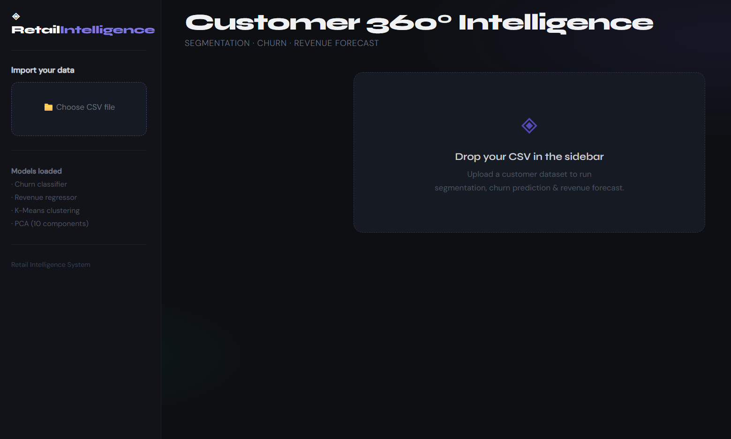

Slide 24









Application Functionalities
Prediction Module
Revenue Estimation
Business Intelligence
Upload data to generate real-time churn predictions utilizing our XGBoost architecture.
Display predicted customer lifetime values derived from historical transaction behaviors.
Visualize K-Means segments to instantly identify VIPs and at-risk demographics.

Slide 25


Conclusion & Future Work
We successfully deployed a unified Retail Intelligence System integrating preprocessing, clustering, classification, and regression.
Achieved
Next Steps
•
End-to-end data pipeline
•
Integration of SHAP for explainability
•
Highly accurate Churn prediction
•
Deep learning-based forecasting
•
Actionable segmentation
•
Real-time streaming data ingestion

